Slide 1
Object classification and localization
Final project – biof509 (spring 2020)
Thomas May

Slide 2
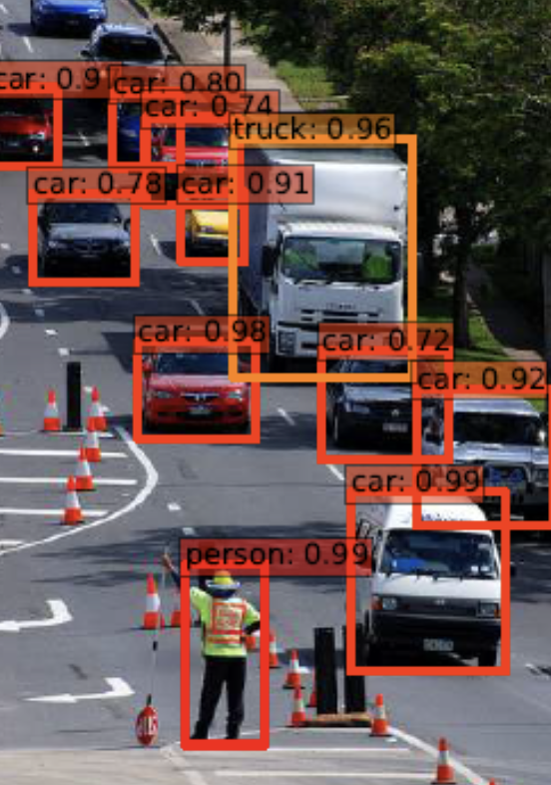
Purpose
Develop a machine learning based automated object detection and tracking capability as part of an unmanned aerial vehicle command, control and communication system

Slide 3
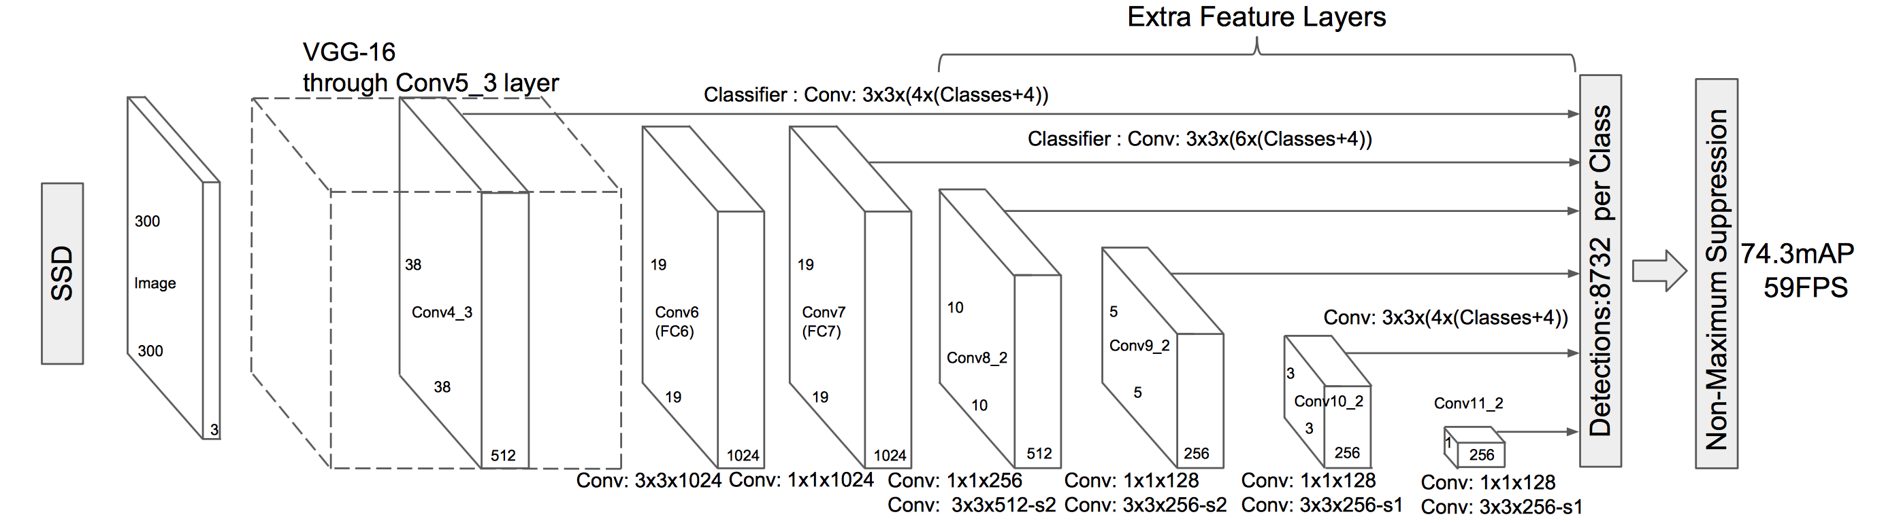
Solution Space
Constraints - Inference Speed (Real time), mAP, memory (mobile platform)
Single Shot Detector (SSD) + Mobilenet V2 + Pretrained COCO
Single Pass vs Two Pass Regional Proposal Networks

Slide 4
Workflow
Acquire Data
Format the Data
Perform Inference
Display the Image

Slide 5
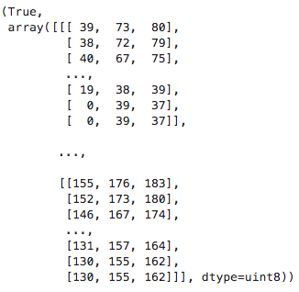
Data Acquisition
Imagery from the aircraft is transmitted as a raw H.264 UDP data stream over WiFi.
OpenCV VideoCapture() is used to reassemble the video packets and converts them to FFMEG video (720, 960, 3).

Slide 6
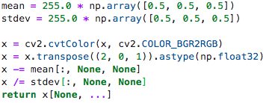
Format the data
Resize – expects 300p x 300p
Color Space – BGR to RGB
Reshape – R,C,P to P, R, C
Normalize Colorspace (-1, 1)

Slide 7
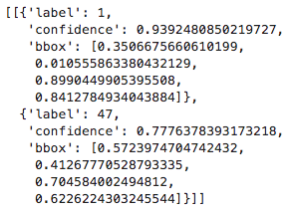
Run Inference
SSD-Mobilenet-V2-COCO Pipeline
Output – Detection, Label, Box
Filter – Select Desired Label
Process Output Image
– Draw Bounding Boxes

Slide 8
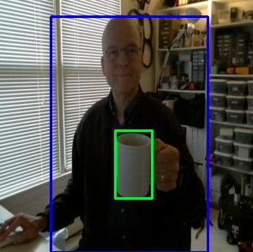
Image with Bounding boxes… ( Sorry no Kittens this time ☺ )

Slide 9
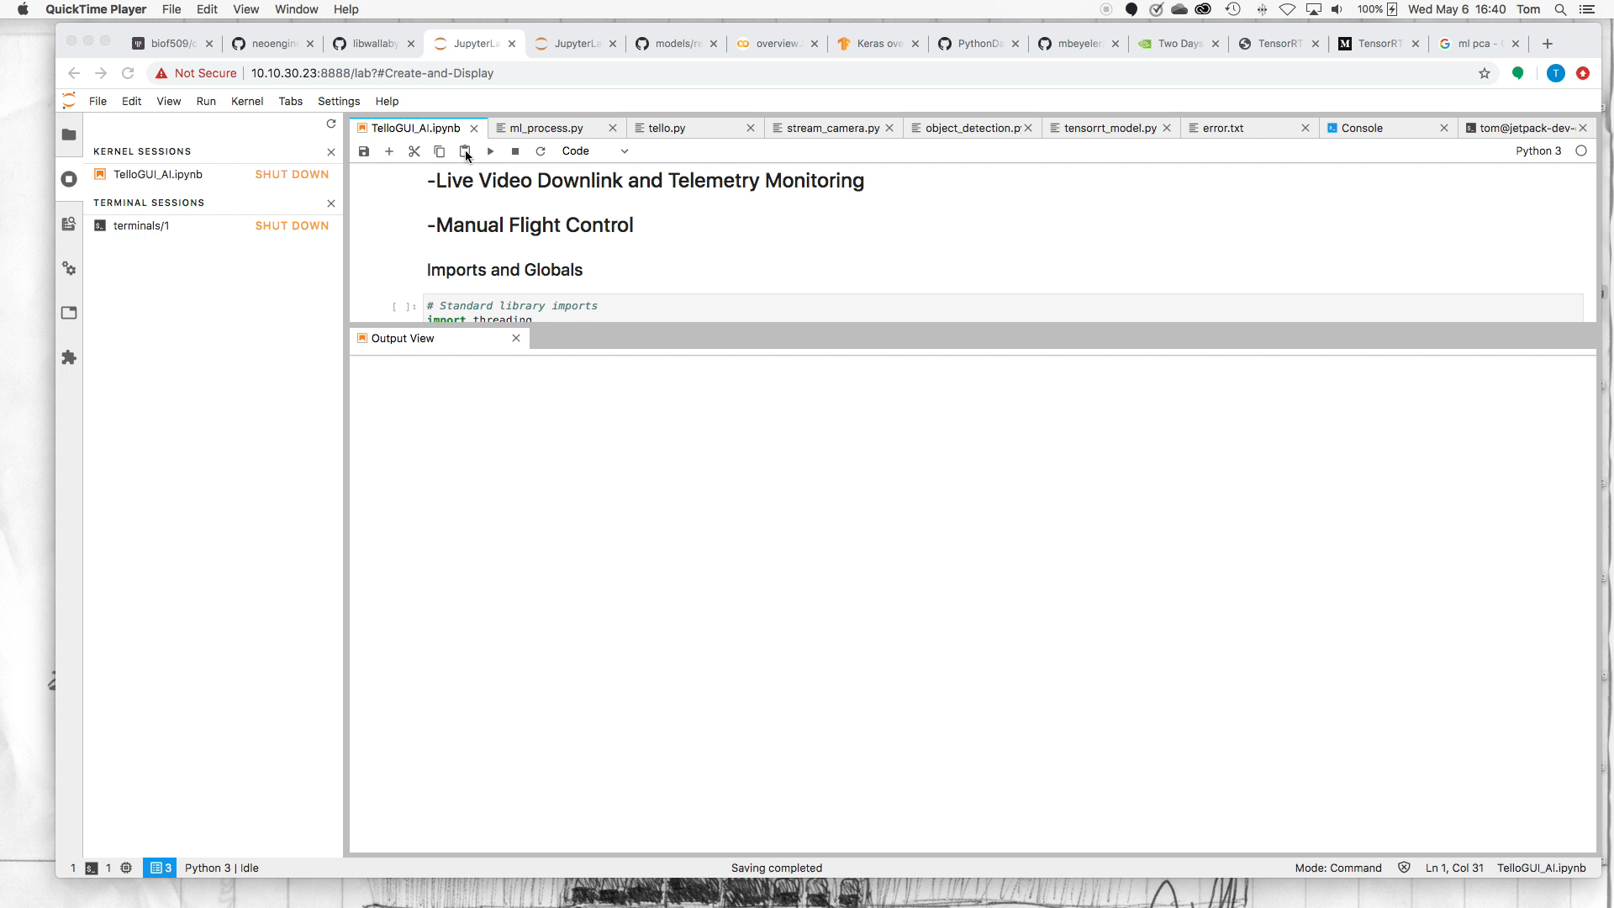
Demo…

Slide 10
References
Understanding SSD-MultiBox
Non-Max Suppression Overview
CCOC Dataset
Mean Average Precision (mAP)
Building / Training a Custom SSD
Unofficial Tello Command and Video Protocols
Tello Vdeo Stream Information
Scaling video in OpenCV
OpenCV VideoCapture() examples
OpenCV imencode examples
OpenCV Inter Area Interpolation

